Slide 1
Credit Card Defaulters & Insurance Premium Analysis

Slide 2
Project Synopsis To track and identify the creditcard defaulters and define the insurance premium according to the list of defaulters by joining data from insurance system, creditcard systems, state code fixed width data and the customer master datasets. Business Analysis and Motive of Project Business requirement is to help the Financial institutions such and Insurance and Banking systems understands the Credit card defaulters to define the Insurance premium accordingly, it analyze a wide variety of online and offline customer data including the customer transactions, customer master data, insurance data etc. Bank can analyze this data to generate insights about individual consumer behaviors and preferences. This tool builds the strategies, Key Performance Indicators (KPI) definitions and implementation roadmaps that assists our esteemed clients in their Analytics & Information ecosystem journey right from Strategy definition to large scale Global Implementations & Support using the bigdata ecosystems.

Slide 3
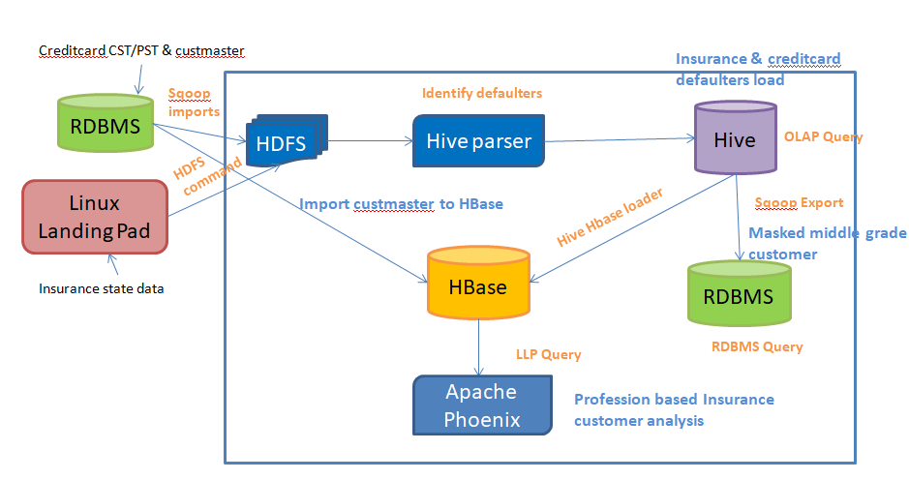
Project Architecture

Slide 4
Project Flow
Data ingestion and acquisition is done through Sqoop and Linux file system.
Merge the 2 dataset using hive and split the defaulters and non-defaulters into 2 data sets and load into hdfs.
Create a hive table with header line count as 1
Create one more fixed width hive table to load the fixed width states_fixedwidth data.
Create a managed table on top of the hive output defaulters dataset
Convert the above managed table from managed to external.
Export the view data into hdfs with comma delimiter, as row format delimited fields terminated by ',' will not work for hdfs export.
Export the above masked data into mysql using sqoop Export the above data into mysql using sqoop
Join insurance and credit card data and load into hbase table created with 2 column families credit and insurance.
Import using sqoop from db into hbase custmaster data.
Create a hbase handler table in hive using hbase storage handler referring to insurancehive table that will be automatically created in hbase with insurance and credit card column families when we create the below hive table.
create a phoenix table view on the above hbase table and analyze profession based total payment and average payment.

Slide 5
Thank You!

